Slide 1

EMPLOYEE ATTRITION PROJECT
A Machine leaning Project by :
PAUL SENTONGO
MARGRET PENINAH NANKYA

Slide 2

According to the Uganda Bureau of Statistics' National Labour Force Survey 2021, there is a notable movement of employees between jobs, which impacts various sectors differently
Human Resource Managers in Uganda have highlighted that this high turnover rate is challenging for companies, as it affects their ability to invest in and retain skilled employees.
Hiring and retaining employees are extremely complex tasks that require capital, time and skills.
“Small business owners spend 40% of their working hours on tasks that do not generate any income such as hiring”.
“Companies spend 15%-20% of the employee's salary to recruit a new candidate”.

Slide 3
Continued…
“An average company loses anywhere between 1% and 2.5% of their total revenue on the time it takes to bring a new hire up to speed”.
Hiring a new employee costs an average of $7645 (0-500 corporation).
It takes 52 days on average to fill a position.

Slide 4
Our goal is to develop a predictive model to identify employees who are likely to quit. This will enable the HR teams to proactively address potential attrition issues.
The dataset used includes various attributes of employees such as Job Involvement, Education, Job Satisfaction, Performance Rating, Relationship Satisfaction, and Work-Life Balance. This data is sourced from a public dataset available on Kaggle. We acknowledge that this dataset is from a different geographical location and may require contextual adaptation for our specific scenario in Uganda.
Data Source: https://www.kaggle.com/pavansubhasht/ibm-hr-analytics-attrition-dataset

Slide 5
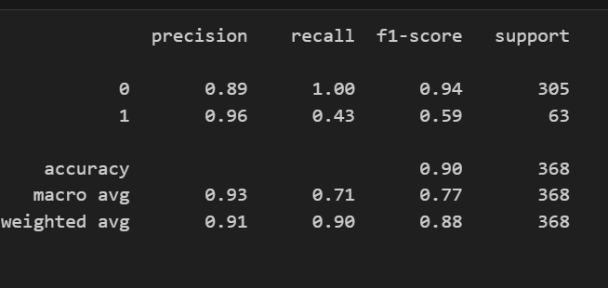
MODEL SELECTION
We have selected the logistic regression classifier model as the best model with accuracy of 90% compared to the Artificial Neural Network and the random forest classifier and metrics summarized.

Slide 6
OBSERVATION
The model performs very well for class 0 but has difficulties correctly identifying all instances of class 1.
For class 0, the model is very good at identifying negative instances (high recall of 1.00). Precision is also quite high (0.89), meaning most predicted negatives are correct. The F1-score of 0.94 indicates a strong balance between precision and recall for this class.
For class 1, while the precision is high (0.96), meaning when the model predicts a positive, it is very likely to be correct, the recall is quite low (0.43). This means that the model misses a significant number of actual positive instances. The F1-score of 0.59 reflects this imbalance.

Slide 7

LOGISTIC REGRESSION CLASSIFIER EXPLAINED
Linear regression is used to predict outputs on a continuous spectrum.
Logistic regression is used to predict binary outputs with two possible values labeled "0" or "1"
Logistic model output can be one of two classes: pass/fail, win/lose, healthy/sick etc.
Example as below.
Hours Studying | Pass/Fail
1 | 0
1.5 | 0
2 | 0
3 | 1
3.25 | 0
4 | 1
5 | 1
6 | 1
PASS/FAIL
LINEAR MODEL
HOURS OF STUDYING

Slide 8
LOGISTIC REGRESSION CLASSIFIER
Now we need to convert from a probability to a class value which is “0” or “1”.
Class 1
LOGISTIC REGRESSION MODEL
PASS/FAIL
0.5
Class 0
THRESHOLD
HOURS OF STUDYING

Slide 9
CONFUSION MATRIX
TRUE CLASS
+
-
TYPE I ERROR
+
TRUE +
FALSE +
PREDICTIONS
FALSE -
TRUE -
-
TYPE II ERROR

Slide 10
CLASSIFICATION MODEL KPIs
A confusion matrix is used to describe the performance of a classiﬁcation model:
True positives (TP): cases when classiﬁer predicted TRUE and correct class was TRUE
True negatives (TN): cases when model predicted FALSE, and correct class was FALSE
False positives (FP) (Type I error): classiﬁer predicted TRUE, but correct class was FALSE
False negatives (FN) (Type II error): classiﬁer predicted FALSE, but they actually correct.
Classiﬁcation Accuracy = (TP+TN) / (TP + TN + FP + FN)
Precision = TP/Total TRUE Predictions = TP/ (TP+FP) (When model predicted TRUE class, how often was it right?)
Recall = TP/ Actual TRUE = TP/ (TP+FN) (when the class was actually TRUE, how often did the classiﬁer get it right?)

Slide 11
PRECISION VS. RECALL
TRUE CLASS
Accuracy is generally misleading and is not enough to assess the performance of a classifier.
Recall is an important KPI
+
-
TP = 1
FP = 1
+
PREDICTIONS
-
FN = 8
TN = 90
Classiﬁcation Accuracy = (TP+TN) / (TP + TN + FP + FN) = 91%
Precision = TP/Total TRUE Predictions = TP/ (TP+FP) = ½=50%
Recall = TP/ Actual TRUE = TP/ (TP+FN) = 1/9 = 11%

